Slide 1
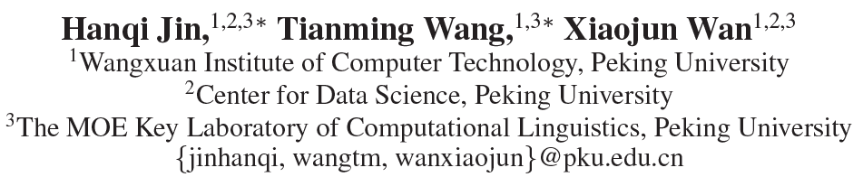
SemSUM: Semantic Dependency Guided Neural Abstractive Summarization
https://github.com/zhongxia96/SemSUM
AAAI-20
瞿春霞
2021年2月7日

Slide 2
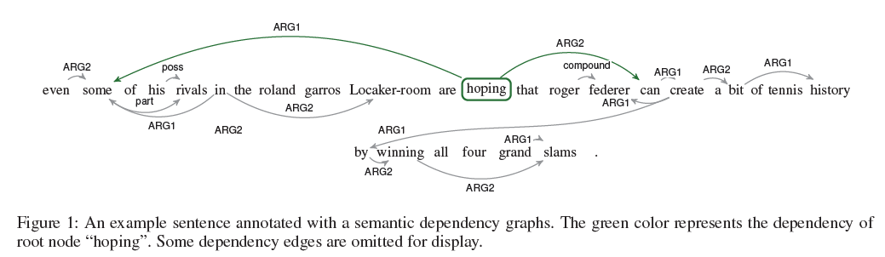
Semantic dependency graph
Source: even some of his rivals in the roland garros locker-room are hoping that roger federer can create a bit of tennis history by winning all four grand slams .
Target: even fellow players keen for federer grand slam dream picture
Seq2seq: federer hoping to win at roland garros
SemSUM: even some rivals hope federer to make grand slam history

Slide 3
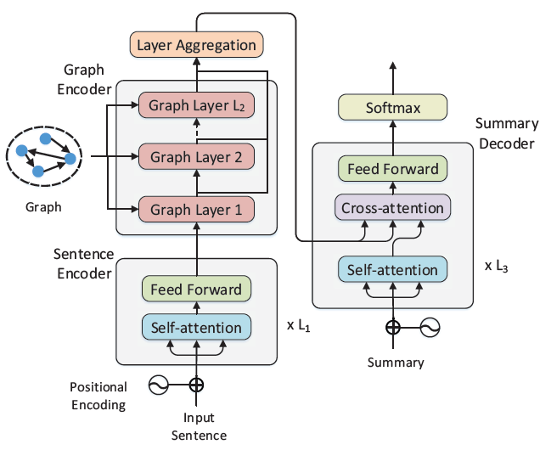
SemSUM model

Slide 4
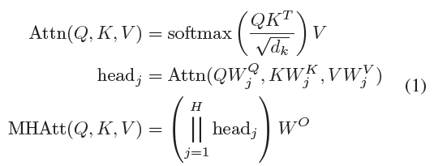

SemSUM model-------Sentence Encoder
Multi-head attention:
Feed forward：

Slide 5
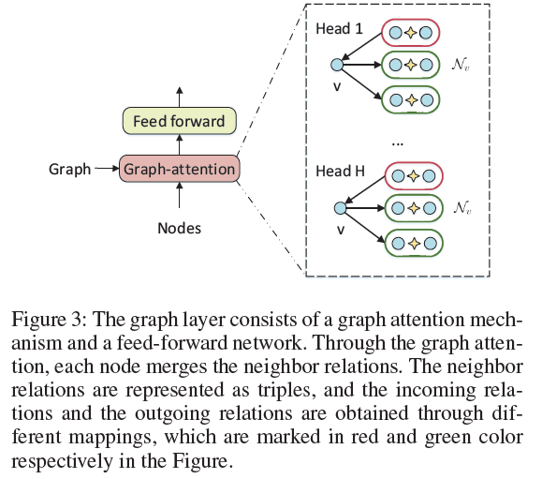

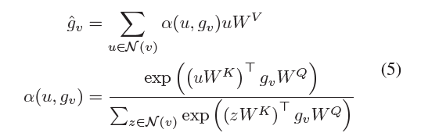



SemSUM model-------Graph Encoder
(head, type, tail)
The representation of each relation:
Representation of node:
Graph attention

Slide 6



SemSUM model-------Summary Decoder
The probability of next word:

Slide 7
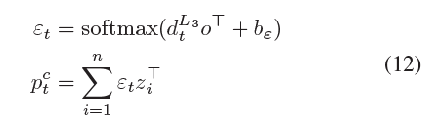


SemSUM model-------Summary Decoder
Copy attention and copy distribution:
Generation probability:
Final distribution:

Slide 8
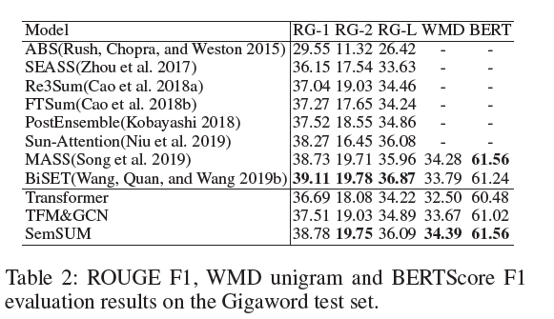
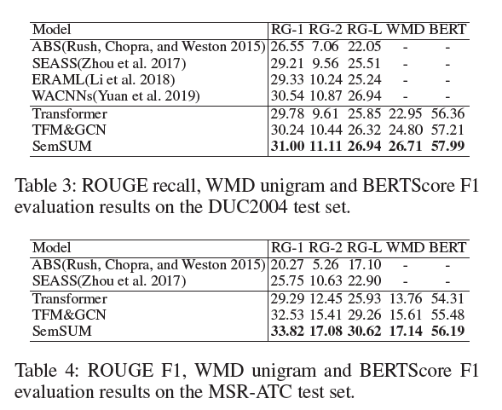
result

Slide 9
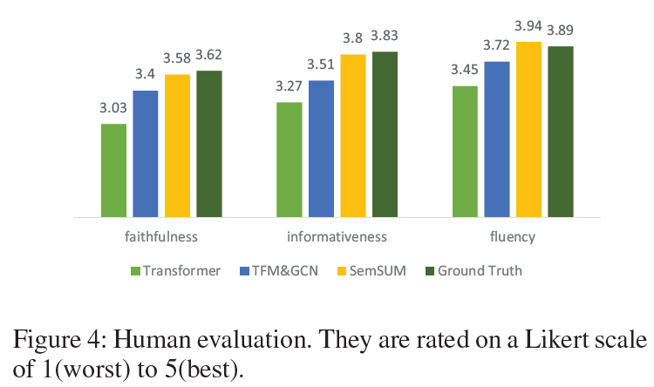
result

